Slide 1



EpicQuest Chronicles
<NAME OF THE PROJECT>
IBRAHIM HASSAN
MOUHIB Yasmine
Python start level 1
2023 – 2024
Notes:
1. INTRODUCTION

Slide 2
<NAME OF THE PROJECT>
EpicQuest Chronicles
IBRAHIM HASSAN
MOUHIB Yasmine
Python start level 1
2023 – 2024
Notes:
1. INTRODUCTION

Slide 3


EpicQuest Chronicles
MOUHIB Yasmine
Python start level 1
2023 – 2024
<NAME OF THE PROJECT>
IBRAHIM HASSAN

Slide 4
<NAME OF THE PROJECT>
Games
IBRAHIM HASSAN

Slide 5
<NAME OF THE PROJECT>
Games
Stories
IBRAHIM HASSAN

Slide 6
<NAME OF THE PROJECT>
Games
Stories
IBRAHIM HASSAN

Slide 7


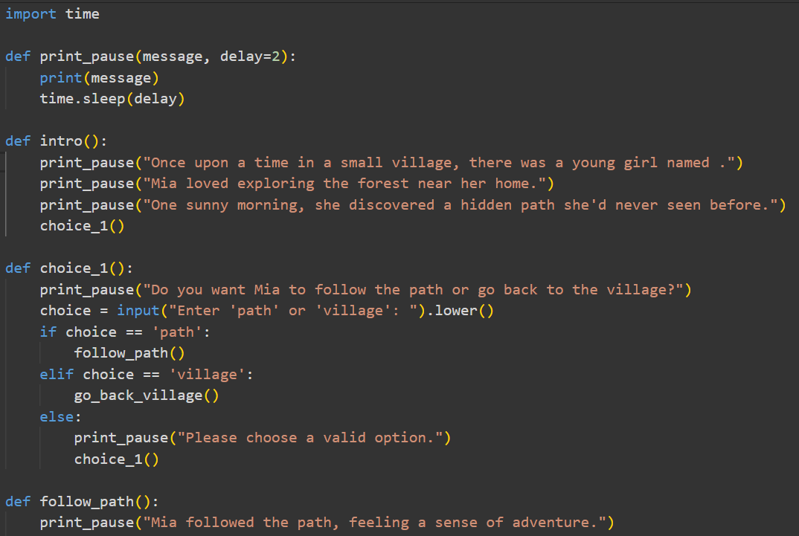
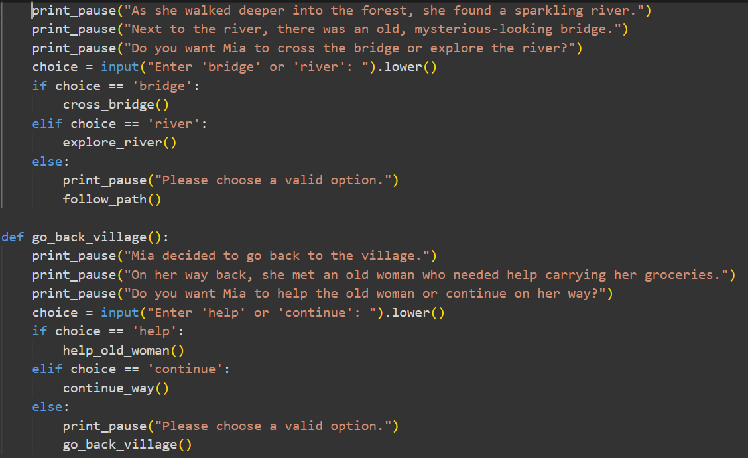
It combines elements of storytelling and adventure, capturing the essence of both a narrative and an interactive game.
<NAME OF THE PROJECT>
Games
Stories
IBRAHIM HASSAN

Slide 8
It combines elements of storytelling and adventure, capturing the essence of both a narrative and an interactive game.
Games
Stories
<NAME OF THE PROJECT>
IBRAHIM HASSAN

Slide 9
<NAME OF THE PROJECT>
IBRAHIM HASSAN

Slide 10
<NAME OF THE PROJECT>
IBRAHIM HASSAN

Slide 11
<NAME OF THE PROJECT>
IBRAHIM HASSAN

Slide 12
<NAME OF THE PROJECT>
Embark on Your Epic Adventure with EpicQuest Chronicles!
Dive into a world where your decisions shape the story. Become a hero in a game that blends immersive storytelling with thrilling gameplay. Start your quest today and forge your destiny in EpicQuest Chronicles!
Join the Adventure Now!
IBRAHIM HASSAN
Contact me : EpicQuestChronicles@gmail.com

Slide 13
<NAME OF THE PROJECT>
Embark on Your Epic Adventure with EpicQuest Chronicles!
Dive into a world where your decisions shape the story. Become a hero in a game that blends immersive storytelling with thrilling gameplay. Start your quest today and forge your destiny in EpicQuest Chronicles!
Join the Adventure Now!
IBRAHIM HASSAN
Contact me : EpicQuestChronicles@gmail.com

